Slide 1





mosAIk

Slide 2
AI for UI
Most important UI
The messiest
Organize it!

Slide 3
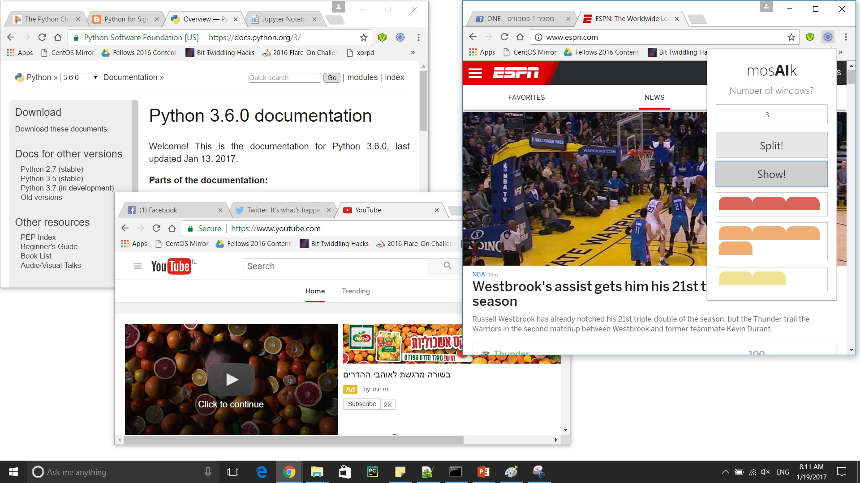
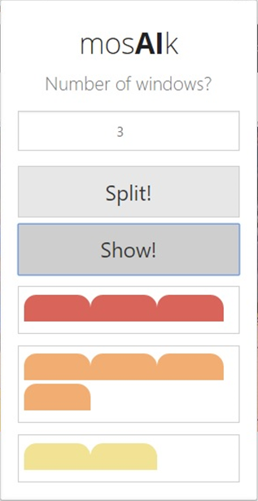
Our Solution

Slide 4




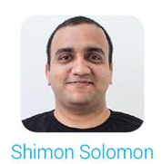
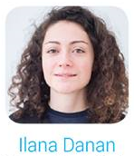

Behind the Scenes
m
o
s
A
I
k
Server
Algorithm
LDA
Client Side

Slide 5
Demo

Slide 6
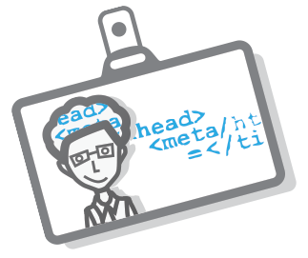

<!--Questions?-->

Slide 7
<!--Thank you!-->

